Slide 1
Open Event
October 2014

Slide 2
Welcome to our first open event!

Slide 3
Introductions
Claire Syms – Headteacher Designate, Halley House School
Gina Thompson – Headteacher, Rutherford House School
Steven Wade – Head of Bellevue UK Schools, BPET Director
Sarah Ryan – BPET Project Director
Simon Ward – BPET Finance & Operations Director
Tom Legge – Lead Proposer, BPET Director

Slide 4
Agenda
The story so far…
Our site
Our vision for Halley House School
What will HHS be like for your child?
How to (and why should you) apply?

Slide 5
Why Dalston?

Slide 6
The story so far…
Identified as one of four areas ideal for a BPET School
Historic links in the community since BSF and The Bridge
Successful submission to DfE in May 2014
Successful applications in Kilburn, Richmond and Barnet
Warm welcome from Local Authority colleagues

Slide 7
The story so far…
Clear critical path to 2015 opening
Key policies approved by DfE
School budget signed off by DfE
Section 10 consultation concluded and with DfE
Proceeding smoothly through DfE phases
Funding Agreement signature scheduled for early 2015
Admissions now open and applications received
What are we asking you to buy into?

Slide 8
Where will the school be?

Slide 9
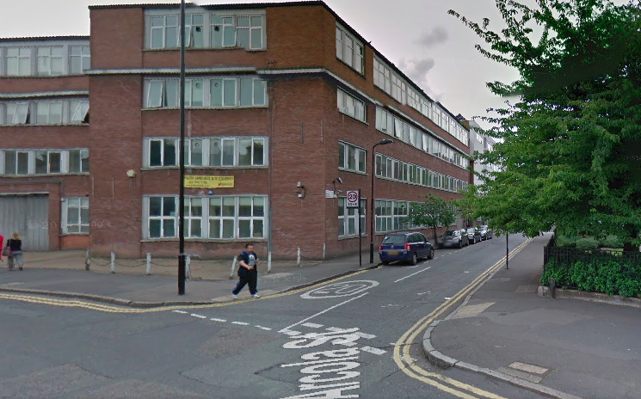
52-58 Arcola Street, E8 2DJ (former Metropole College)

Slide 10
Update on the site
Architects appointed
Initial drawings reviewed
Exploring collaborations with other local schools
Plan for works to be complete in time for opening

Slide 11
Our vision

Slide 12
Bellevue Place Trust: Vision
We believe children’s enjoyment and interest will be a key element in their success
Our schools will plan learning meticulously to ensure all children make strong progress
All our teachers will have Qualified Teacher Status
Our schools will share resources and expertise with the community and other local schools

Slide 13
Bellevue Place Trust: Vision
All our schools will have a Governing Body drawn from the local community
Parents will be involved in the Governance of the school: Two parents elected to the Governing Body
All parents will be warmly welcome and will be strongly supported through information meetings, the school website and regular reporting

Slide 14
What will the new school be like?
All children welcome: no entry requirements, no fees
Curriculum based on the National Curriculum and Bellevue Education’s own to create an inspiring programme of learning
Strong focus on literacy and numeracy
IT will be an important theme throughout

Slide 15
The School Day
7:45am – Breakfast club
8:20am – School gates open
8:40am – School day begins
3:20pm – School day finishes
4:20pm – After school clubs finish
6.00pm – After care finishes

Slide 16
Who will lead the school?

Slide 17
Introducing our Headteacher
Outstanding candidate in a strong field
Currently Deputy Head at Outstanding School in Hackney
PGCE student Lead Mentor
Read Write Inc Trainer
…Introducing Claire Syms

Slide 18
Claire Syms
Headteacher Designate
Halley House School

Slide 19
Gina Thompson
Headteacher
Rutherford House School

Slide 20
Apply to our school with NO RISK!

Slide 21
Applying for a Place
Halley House is outside the LA admissions round
Application to our school has no affect on your LA choices
In effect parents get a ‘bonus choice’
Same timescales as the LA process
Closing date: 15 January 2015
Notification date: 16 April 2015
If you’re lucky you will be offered two great places
Apply directly to the school via our website
30 x 2 Reception places available for 2014

Slide 22
In summary
We’re making great progress towards opening in 2015
We’re totally committed to the local area and Dalston
We’ve got a proven educational model
We’ve hired a superstar Headteacher
This school will be from the community, for the community, governed by the community
We just need you to make it happen!

Slide 23
Thank you for your ongoing support!

Slide 24
Any Questions?

